Slide 1


micro:bit robot entry tutorial
Lesson 4
micro:bit robot lesson 4 “Sing and dance”
YahBoom micro:bit video tutorial

Slide 2
micro:bit robot entry tutorial
Content
Part1
Part 2
Part3
Part 4
Part 5
Learning goals
Preparation
Search for blocks
Combine blocks
Music score
YahBoom micro:bit video tutorial

Slide 3
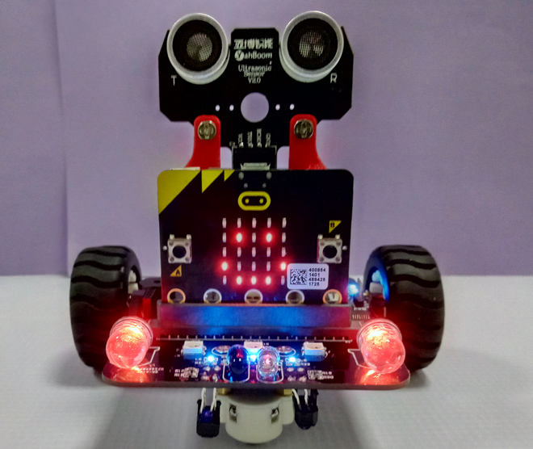
micro:bit robot entry tutorial
Part 1
Learning goals
After you download the program, press the A button, you can hear the robot singing "little apple", and the car completes the move forward, back, left rotation, right rotation and other dancing movements, and there is a special effect with the rhythm of the light, children, try it together.
YahBoom micro:bit video tutorial

Slide 4
micro:bit robot entry tutorial
Part 2
Hardware:
● 1 X USB cable
● 1 X micro:bit robot
Preparation
Then the micro:bit is connected to the computer through USB, and the computer will pop up a U disk and click the URL in the U disk to enter the programming interface. Input this URL https://github.com/lzty634158/yahboom_mbit_en to get the package.
YahBoom micro:bit video tutorial

Slide 5
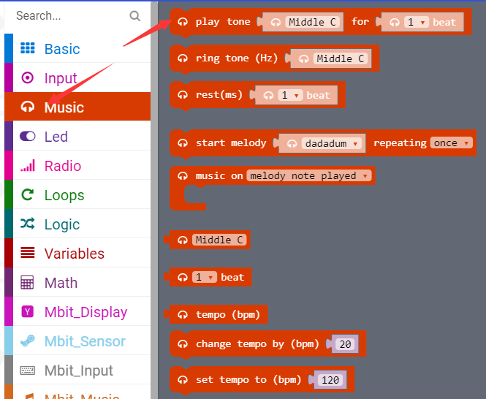
micro:bit robot entry tutorial
Part 3
Search for blocks
YahBoom micro:bit video tutorial

Slide 6
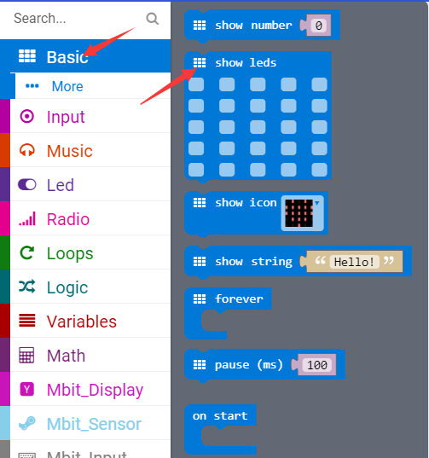
micro:bit robot entry tutorial
Part 3
Search for blocks
YahBoom micro:bit video tutorial

Slide 7
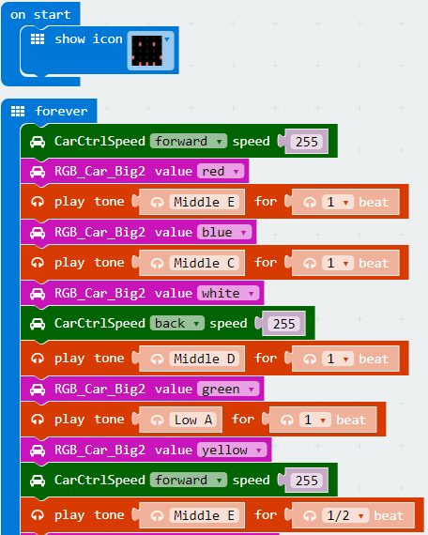
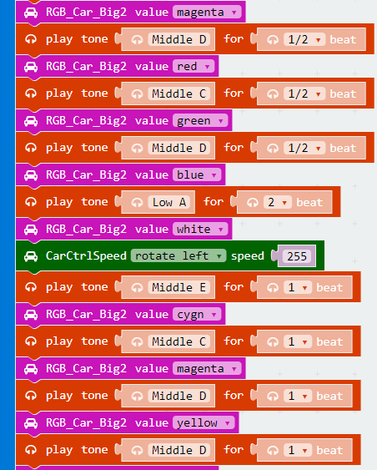
micro:bit robot entry tutorial
Part 4
Combine blocks
YahBoom micro:bit video tutorial

Slide 8
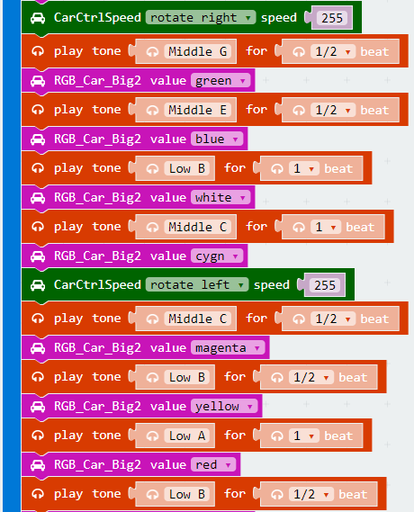
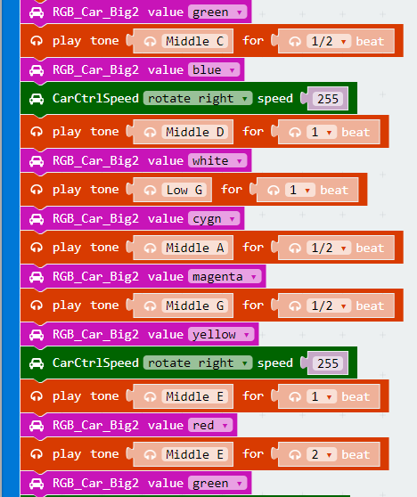
micro:bit robot entry tutorial
Part 4
Combine blocks
YahBoom micro:bit video tutorial

Slide 9
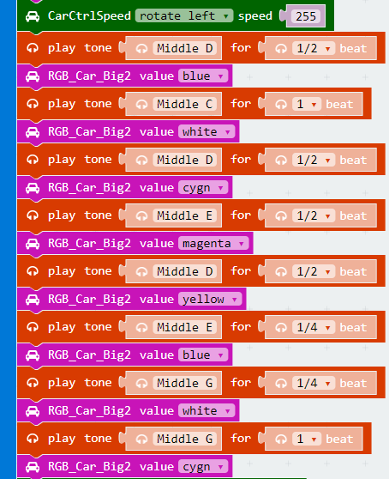
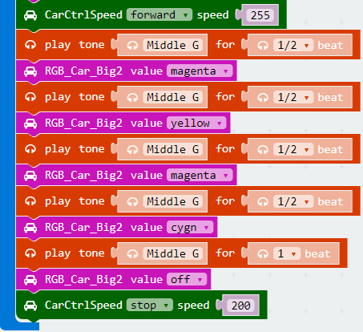
micro:bit robot entry tutorial
Part 4
Combine blocks
YahBoom micro:bit video tutorial

Slide 10
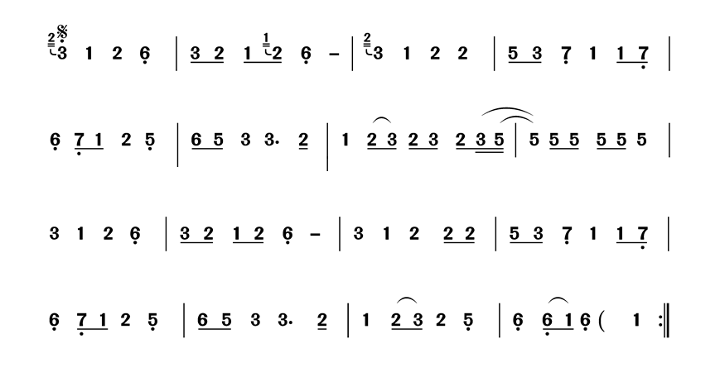
micro:bit robot entry tutorial
Part 5
Music score
YahBoom micro:bit video tutorial

Slide 11
micro:bit robot entry tutorial
Part 4
We turn the numbers in the score into blocks in our program. I have tried many times that the blocks in this song are the best.
1 2 3 4 5
Music score
After watching the tone, let's get to know the beat again,If the number underlines the underline, we set its beat to be 1/2; if there is a horizontal bar behind the number, we set its beat to 2; if only a single number, the beat is 1; if the song does not hear the pause, we can also put a 1 /16 beat in the middle as a pause.
YahBoom micro:bit video tutorial

Slide 12
micro:bit robot entry tutorial
robot
lesson
Thanks for watching！
Powered by YahBoom
YahBoom micro:bit video tutorial

